Slide 1
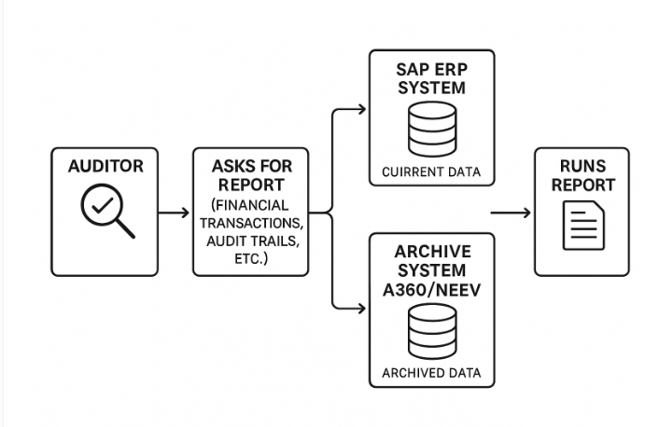
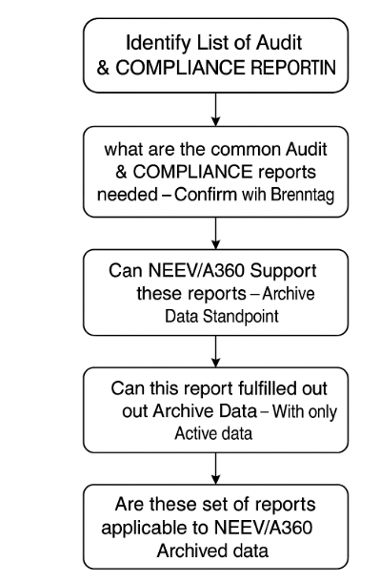
From Auditor point of View
Note to Ferry, below text is for ferry to copy . It can be removed
Identify List of Audit & COMPLIANCE REPORTS
what are the common Audit & COMPLIANCE reports needed - Confirm with Brenntag
Can NEEV/A360 Support these reports - Archive Data Standpoint
Can this report fulfilled with out Archive Data - With only Active data ( Data inside SAP)
Are these set of reports applicable to NEEV/A360 - Archived data

Slide 2
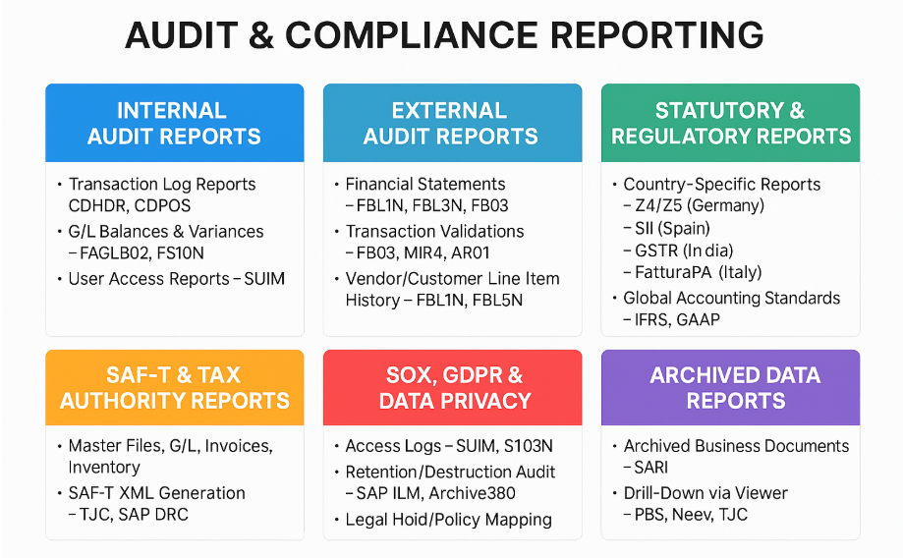
Audit & COMPLIANCE REPORTING
Note to Ferry – The text here is for you so that you can copy in to the digrams.
AUDIT & COMPLIANCE REPORTING1. Internal Audit ReportsTransaction Log Reports – CDHDR, CDPOSG/L Balances & Variances – FAGLB03, FS10NUser Access Reports – SUIMApproval Workflow Logs – SAP Workflow Viewer2. External Audit ReportsFinancial Statements – FBL1N, FBL3N, FB03Transaction Validations – FB03, MIR4, AR01Vendor/Customer Line Item History – FBL1N, FBL5NAsset Register Reports – AW01N, AR013. Statutory & Regulatory ReportsCountry-Specific ReportsZ4/Z5 (Germany)SII (Spain)GSTR (India)FatturaPA (Italy)Global Accounting Standards – IFRS, GAAP4. SAF-T & Tax Authority ReportsMaster Files, G/L, Invoices, InventorySAF-T XML Generation – TJC, SAP DRCCompliance with EU Tax Directives5. SOX, GDPR & Data PrivacyAccess Logs – SUIM, ST03NRetention/Destruction Audit – SAP ILM, Archive360Legal Hold/Policy Mapping6. Archived Data ReportsArchived Business Documents – SARIDrill-Down via Viewer – PBS, Neev, TJCAudit Evidence from Decommissioned Systems

Slide 3
Audit & COMPLIANCE REPORTING – Which scenarios ( NEEV/A360) we are covering
Audit Category | Report Type | Typical Tools/Transactions | Purpose | Frequency | Brenntag Needs (Y/N) | Does NEEV Supports ( Y/N)
Internal Audit reports | Transaction Log Reports | CDHDR/CDPOS | Track who made changes and when | As needed during audits or investigations
 | G/L Balances & Variances | FAGLB03, FS10N | Verify account balances and postings | Quarterly or annually
 | User Access Reports | SUIM | Check if users have correct roles and no SoD conflicts | Quarterly or during access reviews
External Audit Reports | Financial Statements | FBL1N, FBL3N, FB03 | Validate financial records for audits | Annually during external audit
 | Transaction Validations | FB03, MIR4, AR01 | Ensure transactions match financial documents | Quarterly or audit-driven
Statutory & Regulatory Reports | Country-Specific Reports | Z4, SII, GSTR, FatturaPA | Meet local government filing requirements | Monthly or per statutory schedule
 | Global Regulatory Compliance | IFRS/GAAP reports | Comply with international accounting standards | Annually
SAF-T | SAF-T Files | TJC Extractor, SAP DRC | Submit tax audit files to authorities in XML format | Per tax authority request (e.g., yearly)
SOX, GDPR & Data Privacy | Data Access Logs | SUIM, ST03N | Track who accessed sensitive data | Monthly or quarterly
 | Retention/Destruction Logs | SAP ILM, Archive360, Neev | Prove data is held and deleted per compliance policy | Yearly or per retention policy
Archived Data Reports | Archived Document Views | SARI, PBS/Neev Viewers | Access archived business documents from decommissioned systems | As needed during audits or system shutdown

Slide 4
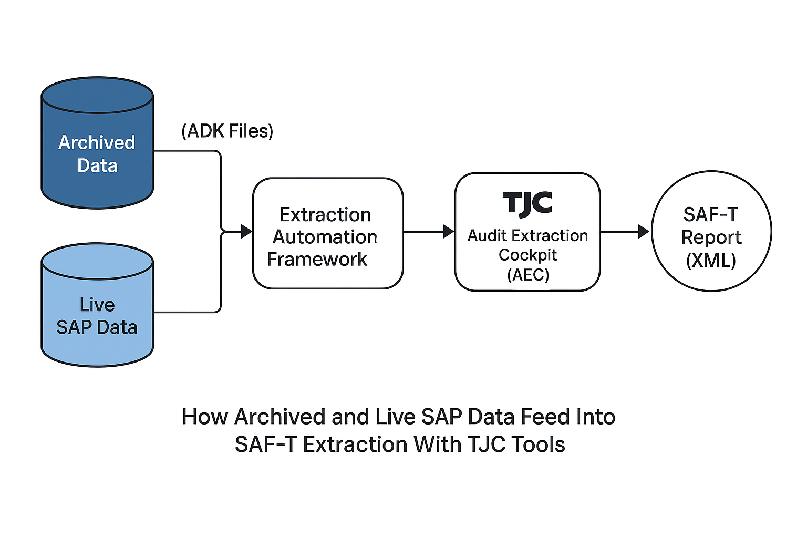
SAP DRC is Good or Still need TJC
TJC Supports Non SAP
Can TJC Supports where more than DRC
Any value brining TJC
DRC – Needs other application to run like BTP , Breenng tag needs to invest – Vishal to confirm
Note - NEEV suggested ( CSV – Comma sepatyed files)

Slide 5
